Slide 1
Receiver operating characteristic
(ROC)
1

Slide 2
Agenda
Receiver operating characteristics curve
Optimum threshold value
2

Slide 3
ROC
An ROC curve (receiver operating characteristic curve) is a graph showing the performance of a classification model at all classification thresholds. This curve plots two parameters:
True Positive Rate
False Positive Rate

Slide 4
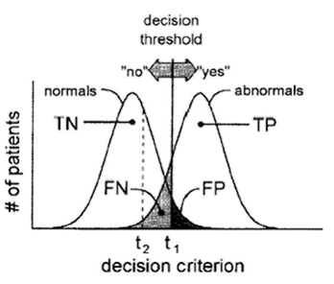
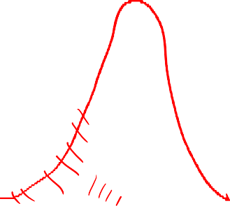
ROC analysis
True Positive Fraction
  TPF = TP / (TP+FN)
  also called sensitivity
  true abnormals called abnormal by the
observer
False Positive Fraction
  FPF = FP / (FP+TN)
Specificity = TN / (TN+FP)
  True normals called normal by the observer
  FPF = 1 - specificity

Slide 5
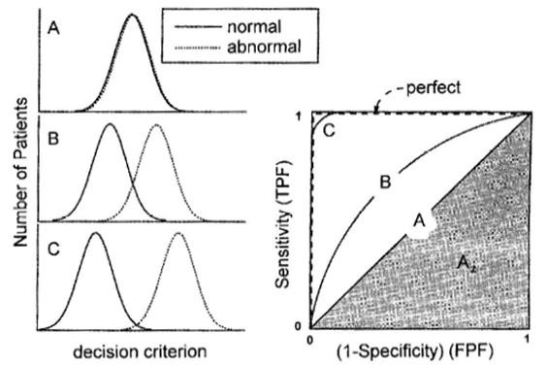
Evaluating classifiers (via their ROC curves)
Classifier A can’t distinguish between normal and abnormal.
B is better but makes some mistakes.
C makes very few mistakes.
  Sensitivity or TPF = TP / (TP+FN)
  Specificity = TN / (TN+FP)

Slide 6
“Perfect” means no false positives and no false negatives.

Slide 7
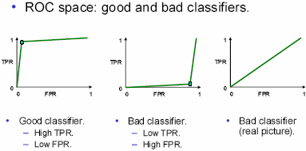
ROC analysis
ROC = receiver operator/operating characteristic/curve

Slide 8
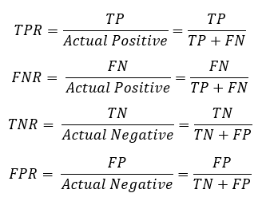

Slide 9
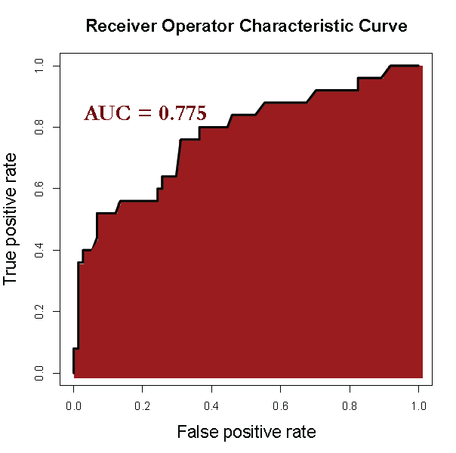
Area Under the ROC Curve (AUC)

Slide 10
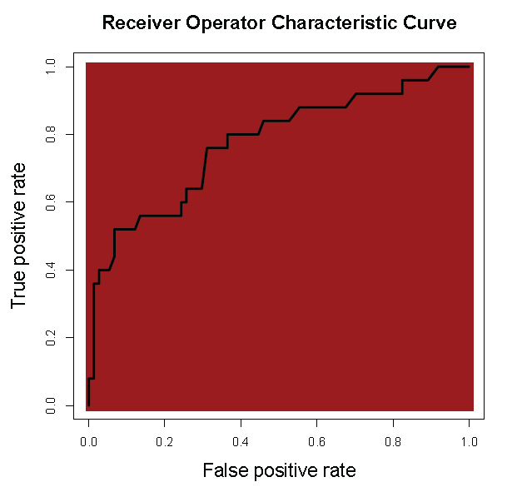
Area Under the ROC Curve (AUC)
What is a good AUC?
– Maximum of 1 (perfect prediction)

Slide 11
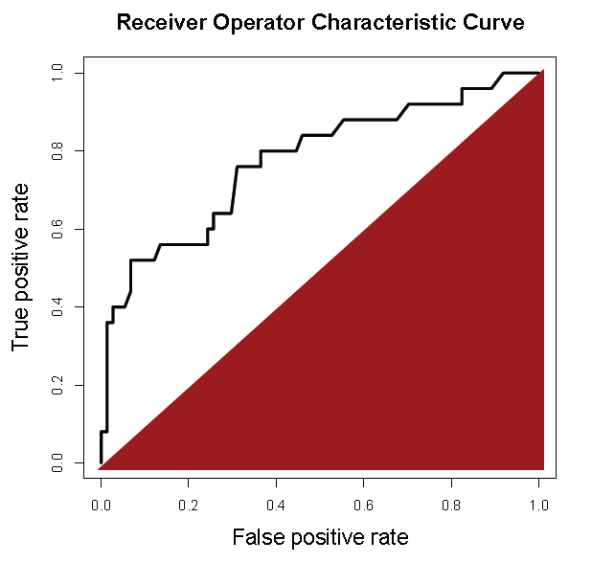
Area Under the ROC Curve (AUC)
What is a good AUC?
Maximum of 1 (perfect prediction)
Minimum of 0.5
(just guessing)

Slide 12
Selecting a Threshold using ROC
Choose best threshold for best trade off
  cost of failing to detect positives
  costs of raising false alarms

Slide 13
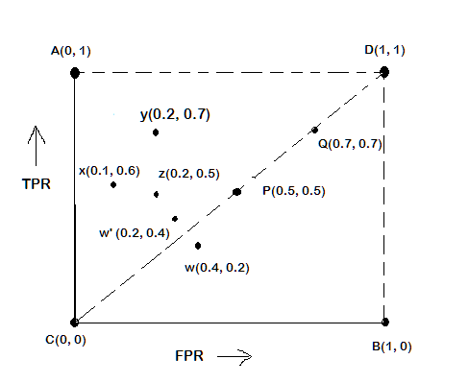
ROC Plot
A typical look of ROC plot with few points in it is shown in the following
figure.
Note the four cornered points are the four extreme cases of classifiers

Slide 14
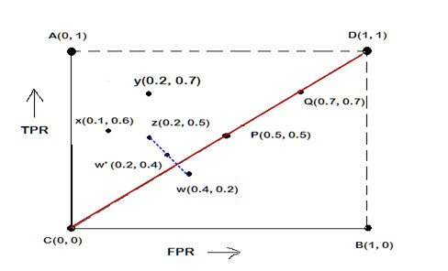
Interpretation of Different Points in ROC Plot
The four points (A, B, C, and D)
A: TPR = 1, FPR = 0, the ideal model, i.e., the perfect classifier, no false results
B: TPR = 0, FPR = 1, the worst classifier, not able to
predict a single instance
C: TPR = 0, FPR = 0, the model predicts every instance to be a Negative class, i.e., it is an ultra-conservative classifier
D: TPR = 1, FPR = 1, the model predicts every instance to be a Positive class, i.e., it is an ultra-liberal classifier

Slide 15
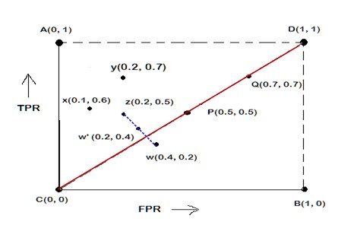

Interpretation of Different Points in ROC Plot
Let us interpret the different points in the ROC plot.
The points on the upper diagonal region
All points, which reside on upper-diagonal region are corresponding to classifiers “good” as their TPR is as good as FPR (i.e., FPRs are lower than TPRs)
Here, X is better than Z as X has higher TPR and
lower FPR than Z.
If we compare X and Y, neither classifier is superior to the other

Slide 16
Interpretation of Different Points in ROC Plot
Let us interpret the different points in the ROC plot.
The points on the lower diagonal region
  The Lower-diagonal triangle corresponds to the classifiers that are worst than random classifiers
  A classifier that is worser than random guessing, simply by reversing its prediction, we can get good results.
W’(0.2, 0.4) is the better version than W(0.4, 0.2), W’ is a mirror reflection of W

Slide 17
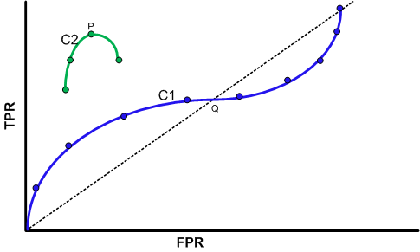
Tuning a Classifier through ROC Plot
Using ROC plot, we can compare two or more classifiers by their TPR and FPR values and this plot also depicts the trade-off between TPR and FPR of a classifier.
Examining ROC curves can give insights into the best way of tuning parameters of classifier.
For example, in the curve C2, the result is
degraded after the point P.
Similarly for the observation C1, beyond Q the settings are not acceptable.

Slide 18
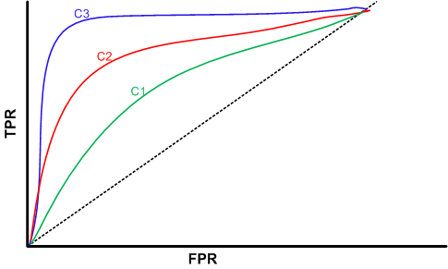

Comparing Classifiers trough ROC Plot
We can use the concept of “area under curve” (AUC) as a better method to compare two or more classifiers.
If a model is perfect, then its AUC = 1.
If a model simply performs random
guessing, then its AUC = 0.5
A model that is strictly better than other, would have a larger value of AUC than the other.
Here, C3 is best, and C2 is better than C1 as AUC(C3)>AUC(C2)>AUC(C1).

Slide 19
ROC curve
100%
True Positive Rate
(sensitivity)
0
%
0
%
False Positive Rate (1- specificity)
100
%

Slide 20
ROC curve comparison
A good test:
A poor test:
100%
100%
True Positive Rate
True Positive Rate
0
%
0
%
0
%
False Positive Rate
100%
0
%
100
%
False Positive Rate

Slide 21
ROC curve extremes
Best Test:
Worst test:
100%
100%
True Positive Rate
True Positive Rate
0
%
0
%
0
%
100
%
0
%
100
False Positive Rate %
False Positive Rate
The distributions
don’t overlap at all
The distributions
overlap completely

Slide 22
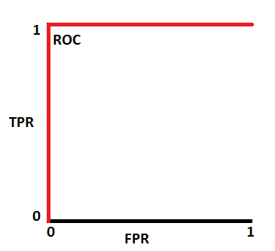
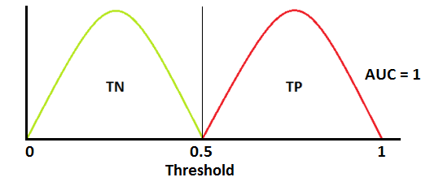
ROC curve extremes

Slide 23
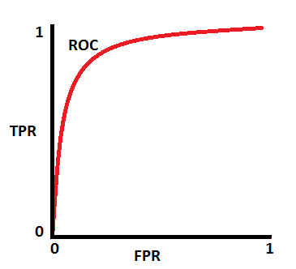
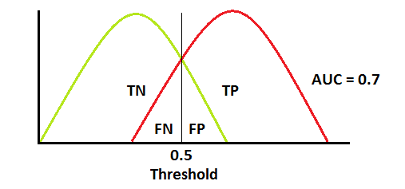
Typical ROC

Slide 24
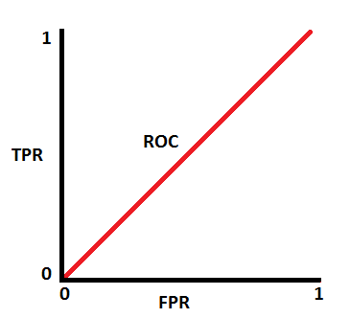
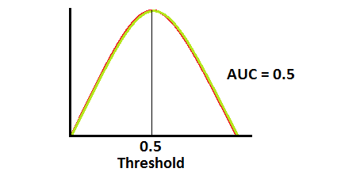
ROC curve extremes

Slide 25
